Slide 1
Software Requirement Engineering
Software Requirement – A more Rigorous Look
Muhammad Nasir
m.nasir@iiu.edu.pk

Slide 2
Outline
Looking deeper into software requirements
The Requirements Dilemma: What versus How
Requirements versus Design
Design Constraints
Notes:
Dilemma: A situation that requires a choice between options that are or seem equally unfavorable or mutually exclusive

Slide 3
Key Points
A complete set of requirements can be determined by defining the inputs, outputs, functions, and attributes of the system plus the attributes of the system environment.
Requirements should exclude project-related information, such as schedules, project plans, budgets, and tests, as well as design information.

Slide 4
Key Points
The requirements/design process is iterative; requirements lead to the selection of certain design options, which in turn may initiate new requirements.
Design constraints are restrictions on the design of the system or on the process by which a system is developed.

Slide 5
Software Requirements & Abstraction
The features, and the use-case model developed for the system were left on purpose at a high-level of abstraction to:
  Better understanding the system
  Assess the system for its completeness, consistency, and its fitness within its environment
  Determine feasibility and to manage the scope of the system before making significant resource investments.
It was sufficient to understand the system at a macro-level view with features and Use-cases

Slide 6
Deeper Look at Requirements
However, as we get closer to implementation, additional specification is required
Davis [1999] suggests that we need five major classes of things in order to fully describe the behavior of a software system

Slide 7
Deeper Look at Requirements
Inputs to the system— not only the content of the input but also, as necessary, the details of input devices and the form
Outputs from the system— a description of the output devices, such as voice-output or visual display, that must be supported, as well as the protocol and formats of the information generated by the system.

Slide 8
Deeper Look at Requirements
Functions of the system— the mapping of inputs to outputs, and their various combinations.
Attributes of the system— such typical non-behavioral requirements as reliability, maintainability, availability, and throughput, that the developers must taken into account.
Attributes of the system environment— such additional non-behavioral requirements as the ability of the system to operate with other applications, loads, and operating systems.

Slide 9
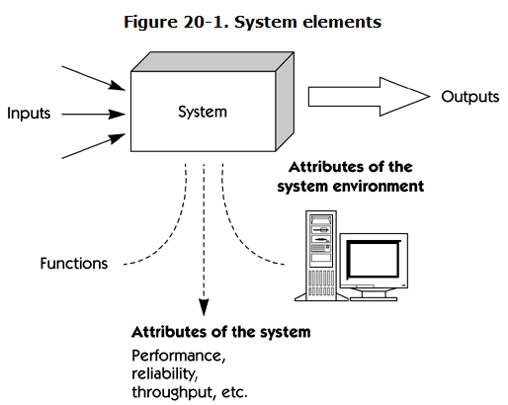
System Elements

Slide 10
Software Requirements and Use Cases
Use cases are a convenient way for certain, but just one way, nonetheless.
In addition, we'll also discover that use cases can't conveniently express certain types of requirements ("the application must support up to 100 simultaneous users"),
and there are better ways to express other types of requirements as well.

Slide 11
Features & Requirements
Features are simple descriptions of systems services described in a shorthand manner.
Software requirements, however, are specific. We can code from them, and they should be specific enough to be "testable”

Slide 12
The Requirements Dilemma: What vs. How
There's a lot of other information that the requirements should not contain.
In particular, avoid any unnecessary design or implementation details, project management details, Testing etc.
Davis [1993] calls this the "what versus how" paradigm
Notes:
Dilemma: A situation that requires a choice between options that are or seem equally unfavorable or mutually exclusive
Paradigm: An example that serves as Pattern or Model

Slide 13

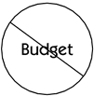
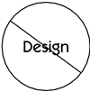
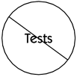
The Requirements Dilemma: What vs. How

Slide 14
Exclude Project Information
Project-related information (such as schedules, configuration management plans, verification and validation plans, budgets, and staffing schedules) is sometimes bundled into the set of requirements
In general, this must be avoided since changes in this information (for example, schedule changes) increase volatility and the tendency for the "requirements" to be out of date.
Notes:
Configuration management (CM) is the ongoing process of identifying and managing changes to deliverables and other work products.

Slide 15
Exclude Project Information
The budget could be construed as a requirement too; however, this is another type of information that doesn't fit our definition
Some strategies may be too expensive or may take too long to carry out.
Nevertheless, they are not system requirements.
Test procedures or acceptance procedures—also don't meet the definition of requirement and therefore don't belong in the requirements.

Slide 16
Excluding Design Information
The requirements should also exclude information about the system design or architecture.
Otherwise, you may accidentally restrict your team from pursuing whatever design options make the most sense for your application
By the way, if you think this is unrealistic, consider the common requirement imposed until the late 1990s by the U.S. Defense Department on its software contractors to build systems using Ada.)

Slide 17
Requirement vs. Design
It is best to understand requirements before design
If we couldn't make these classifications at all, we couldn’t differentiate requirements from design.
Further, we would no longer know who is responsible for what in the development process.
Even worse, our customers would dictate design, and our designers would dictate requirements

Slide 18
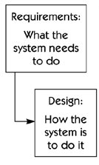
Requirement vs. Design

Slide 19
Iterating Requirements and Design
In reality, the requirements versus design activities must be iterative.
Requirement's discovery, definition, and design decisions are circular.
The process is a continually give and take

Slide 20
Iterating Requirements and Design
Occasionally, inclusion of a new technology may cause us to throw out a host of assumptions about what the requirements were supposed to be.
We may have discovered an entirely new approach that obviates the old strategy. ("Let's throw out the entire client/data access/GUI module and substitute a browser-based interface.")

Slide 21
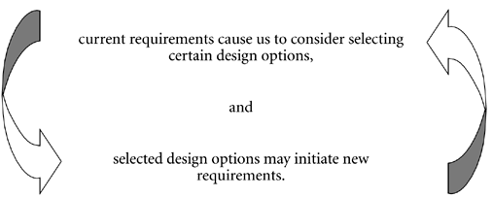
Iterating Requirements and Design

Slide 22
A Further Characterization of Requirements
The preceding discussions on requirements suggested that various "kinds" of requirements exist.
Specifically, we have found it useful to think about three types of requirements
  Functional software requirements
  Nonfunctional software requirements
  Design constraints

Slide 23
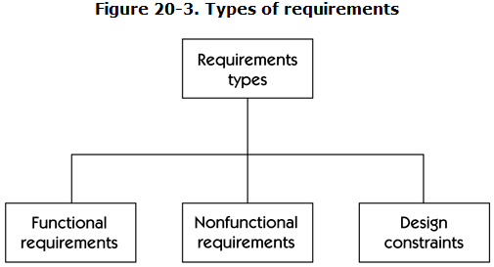
Types of Requirements

Slide 24
Design Constraints
Design constraints typically impose limits on the design of the systems.
“Restrictions on the design of a system, or the process by which a system is developed, that do not affect the external behavior of the system but that must be fulfilled to meet technical, business, or contractual obligations”

Slide 25
The End
Thanks for listening
Questions would be appreciated.

